Slide 1
Instructions for sharing the presentation on the ZOOM

Slide 2
1. To share a PowerPoint presentation, you must first open the PowerPoint application and switch between different windows to return to the ZOOM platform.

Slide 3
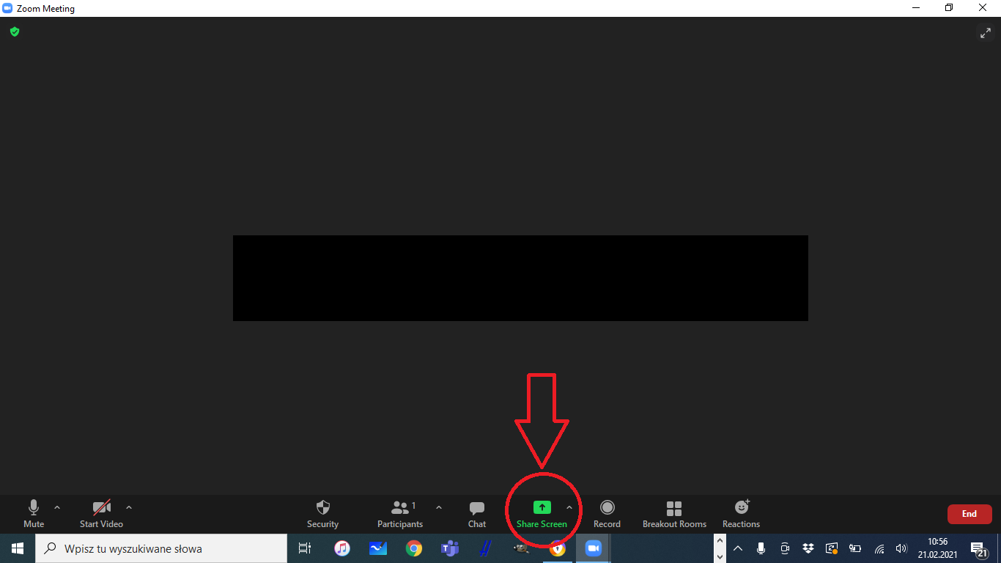
2. To share the screen, select the "Share Screen" button on the ZOOM bar.

Slide 4
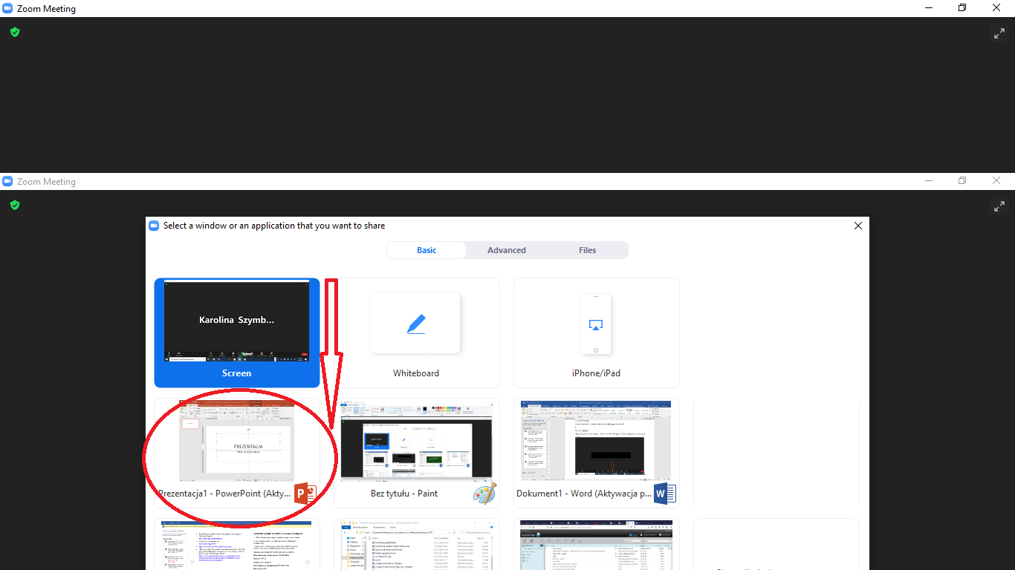
3. Select the PowerPoint application with the document.

Slide 5
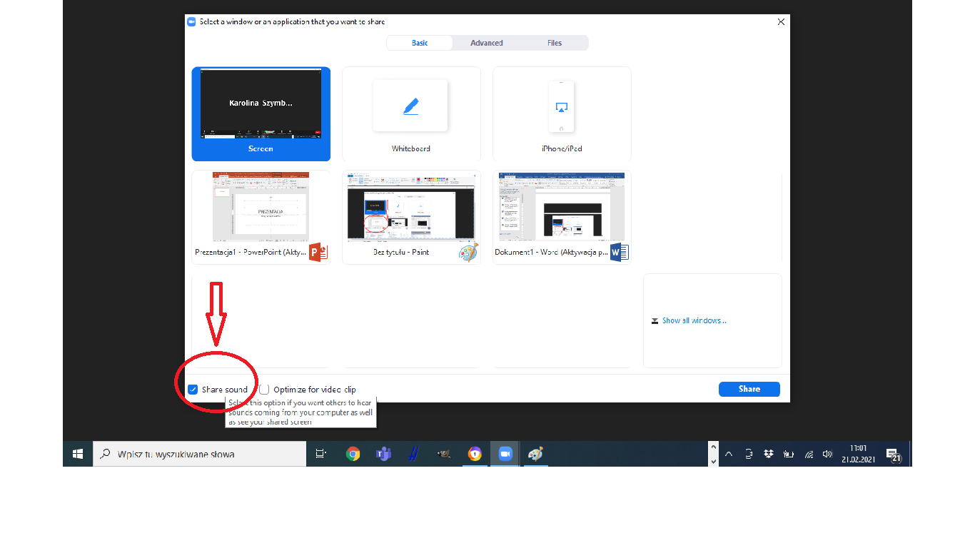
4. Please check if audio sharing is enabled. If not - please select the "Share sound" button.

Slide 6
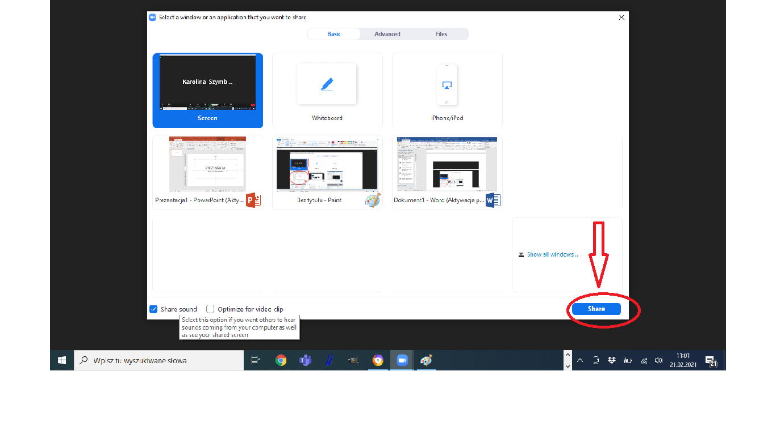
5. Finally, click on "Share" and start the slideshow.

